Slide 1
Marker-Based Underwater Human Skeletonization & Posture Detection

Slide 2
Underwater Motion Capture
Motion capture (mocap) has been a ground-breaking achievement in understanding movement on land, but the underwater environment presents unique challenges and opportunities for exploration.
Underwater human motion capture is a specialized technique that allows us to study and analyze human movement in the aquatic environment.
It involves tracking the positions and orientations of markers placed on a person's body while they perform various activities underwater
Capturing and analyzing human movements below the water's surface, gives us the insights into the hydrodynamics of swimming and diving. This information helps us understand how humans interact with water, optimizing performance, and enhancing safety in aquatic environments

Slide 3
Limitations
Lighting:
Scarcity of light makes underwater motion capture very difficult as markers can easily become invisible to the tracking cameras.
Marker adhesion:
Traditional markers used in motion capture may have difficulty adhering to wet skin or clothing underwater. This can lead to marker displacement, resulting in tracking errors and incomplete data.
Reliable sensors:
Motion capture sensors, cameras, and other equipment need to be specially designed and waterproofed to function effectively and reliably in the underwater environment. Ensuring the robustness and durability of equipment is crucial to maintain data integrity.

Slide 4
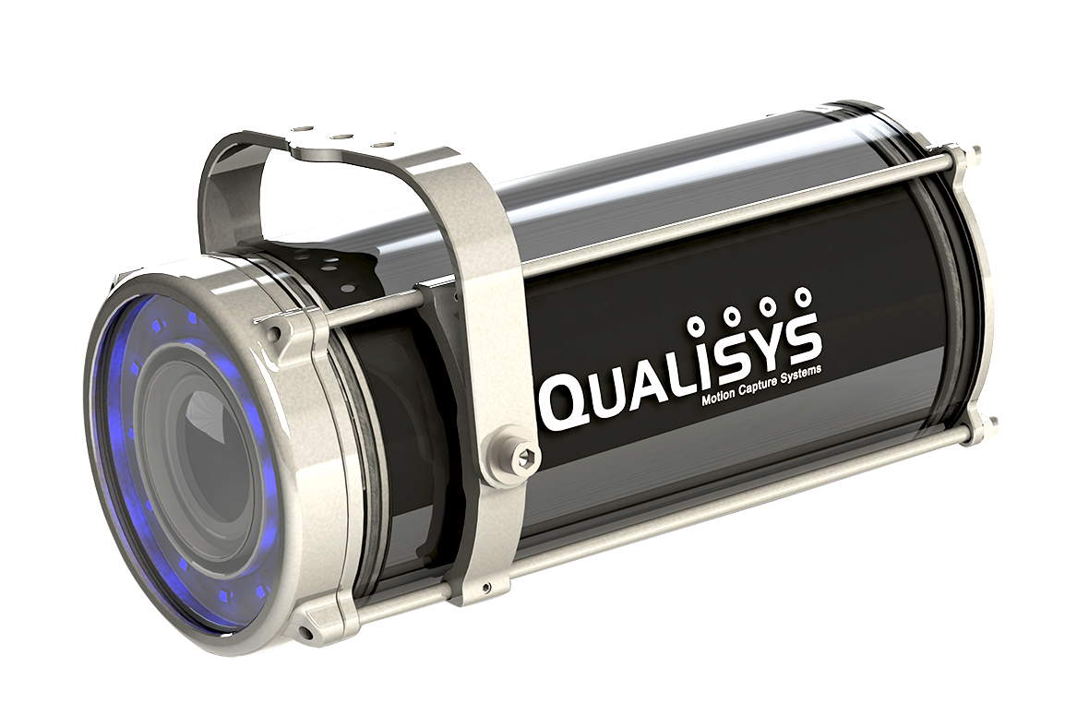
Qualisys Underwater Motion Capture System.
The Qualisys Underwater Motion Capture Camera System has the capability to offer precise and accurate motion capture in an aquatic environment.
The Miqus underwater system enables real-time tracking and analysis of movement beneath the water's surface, providing data for diverse applications.
Strategically positioning the advanced underwater cameras, allows the system to capture movements of a subject with detail and clarity.
Qualisys underwater cameras are the world's only commercially available optical motion capture cameras for underwater use.[1]

Slide 5
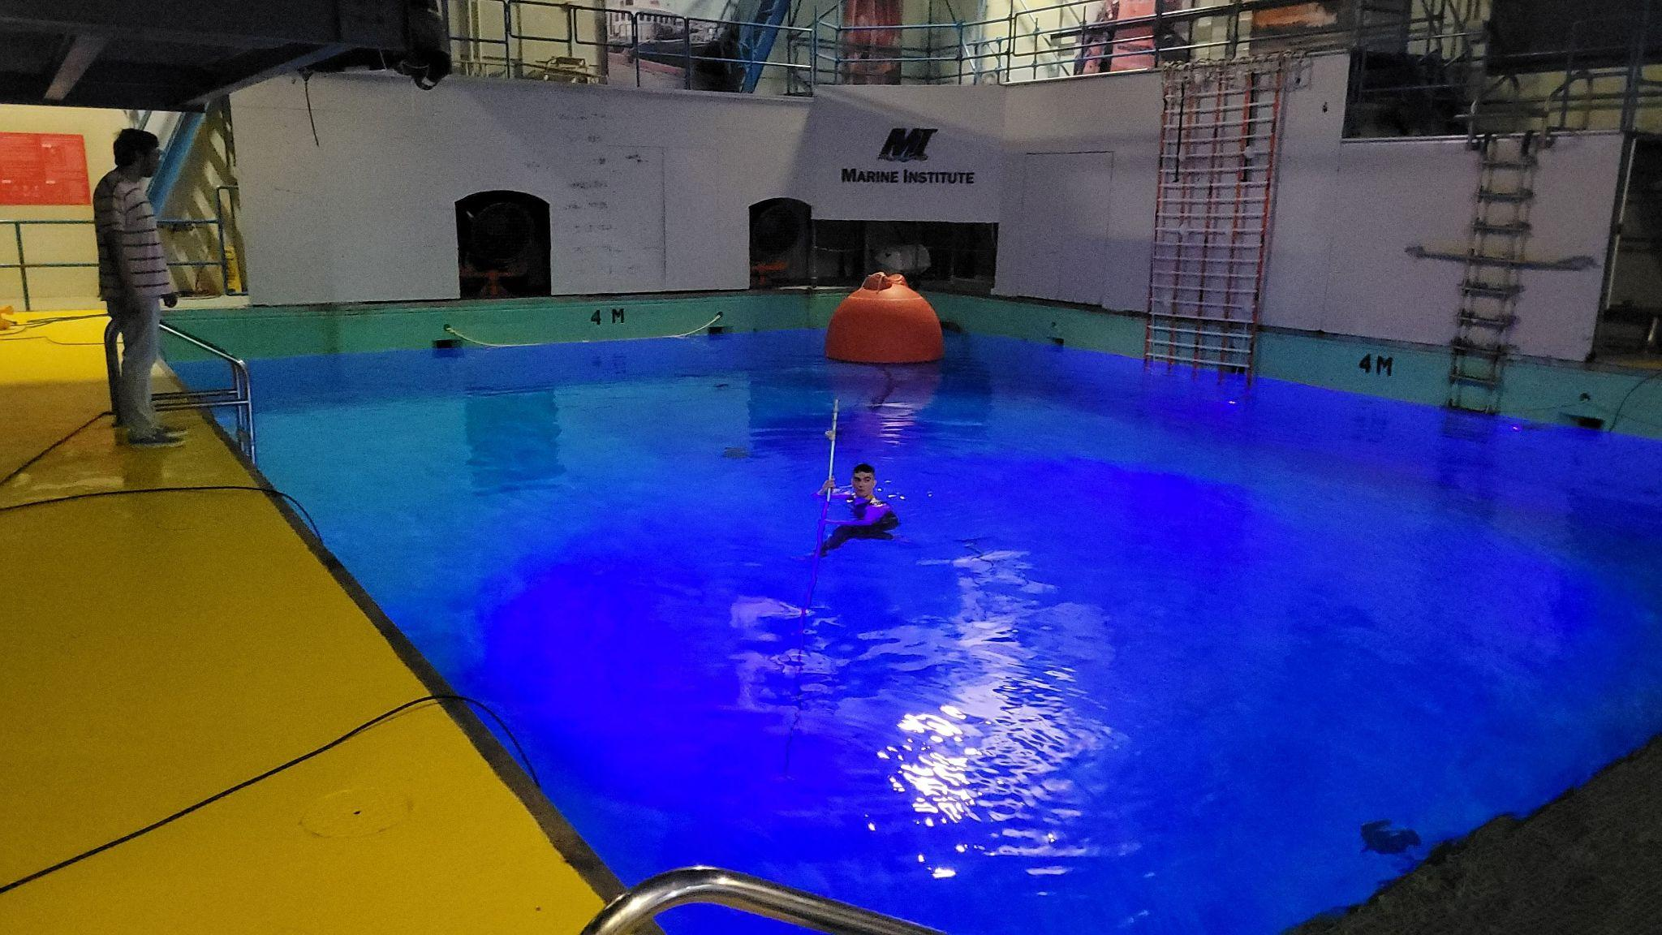
Continued…
The system uses 3D orbs to reflect light to the cameras and collects the location information of each orb.
For the purposes of this project 7 Qualisys Miqus Cameras were used in a 4 meter deep pool.
The cameras were fitted on two sides of the pool, with varying depth.

Slide 6
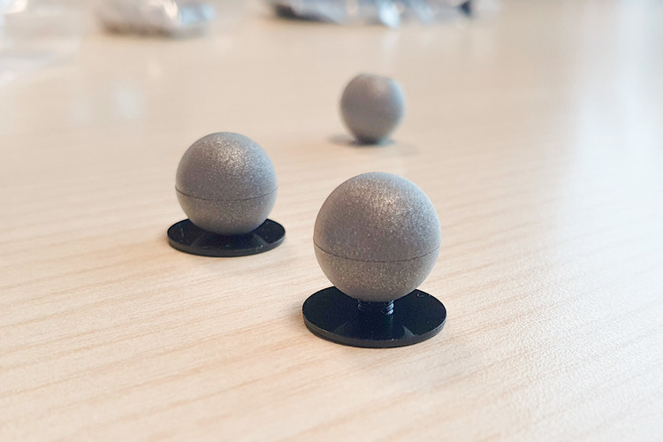
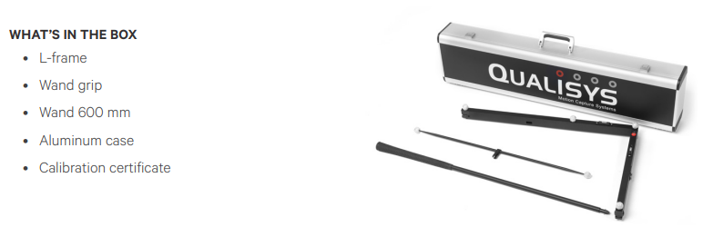
Equipments
The marker orbs used for tracking are of smooth reflective surfaces.
A calibration tool box was provided to calibrate the system after installation of the cameras.

Slide 7
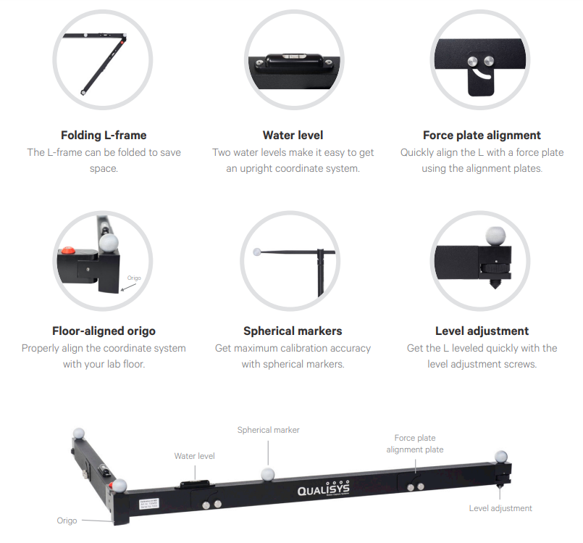
Calibration tools
The L shaped calibration tool has five components. These provide information such as
the depth of water,
proper alignment of the coordinate system with the pool floor,
maximum calibration accuracy with spherical markers,
Quick level adjustment with screws,
Easy alignment with force plates for uneven surfaces.

Slide 8
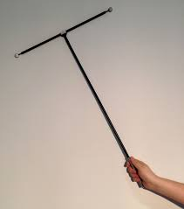
Calibration tools continued…
A calibration wand is provided for the calibration process.
After initializing the calibration process in the Qualisys Track Manager (QTM) software, the wand has to be waved near the L shaped calibration tool inside the camera Field of View.
The QTM software will use the cameras to capture the markers on the calibration tools and determine the origin of the tracking environment.

Slide 9
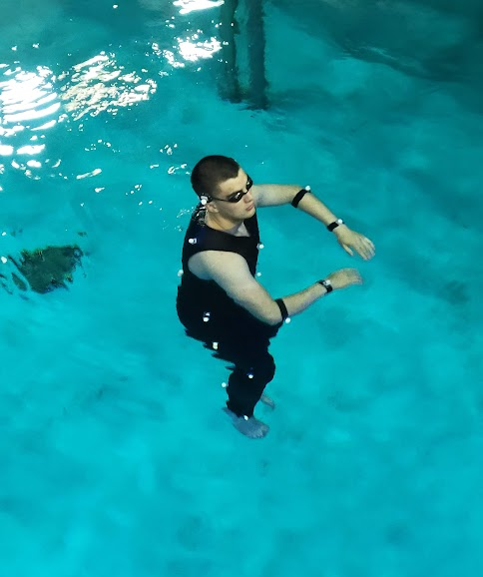
Fitting Markers
A total of 21 markers were attached onto our subject/diver for collecting data.
The markers were stuck on different parts of the body, using various methods, indicating different body parts and joints which will be tracked.
The First day was a trial run, where we learned to set up and use the system. So no usable data was recorded on that day.
The Second day of data collection provided usable data for training.

Slide 10
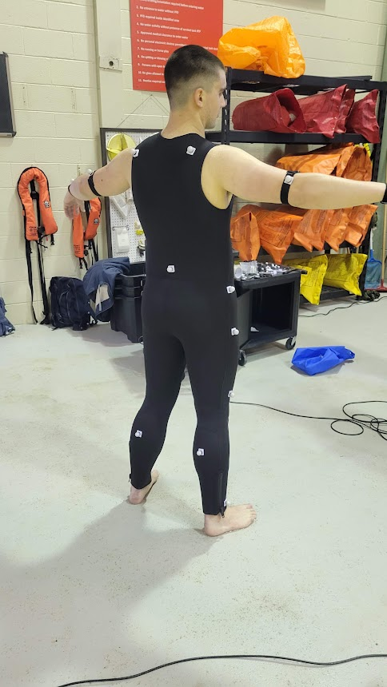
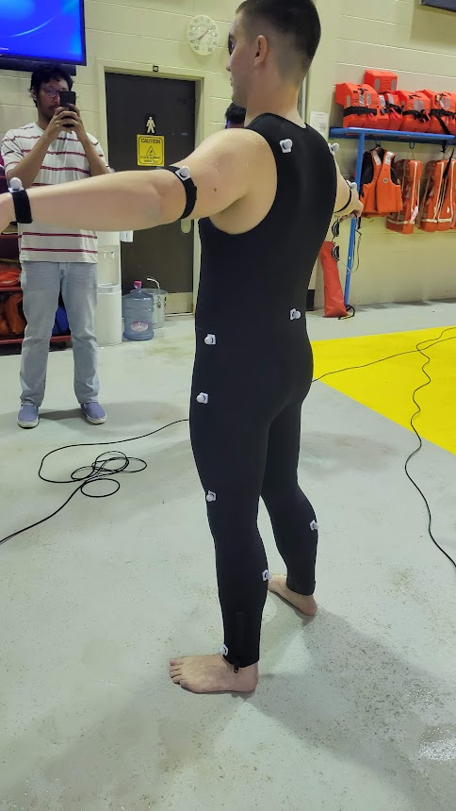
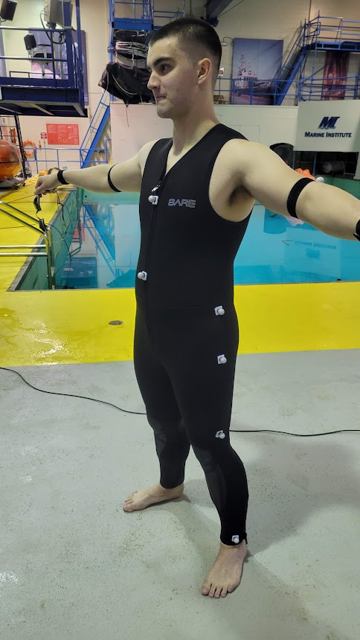
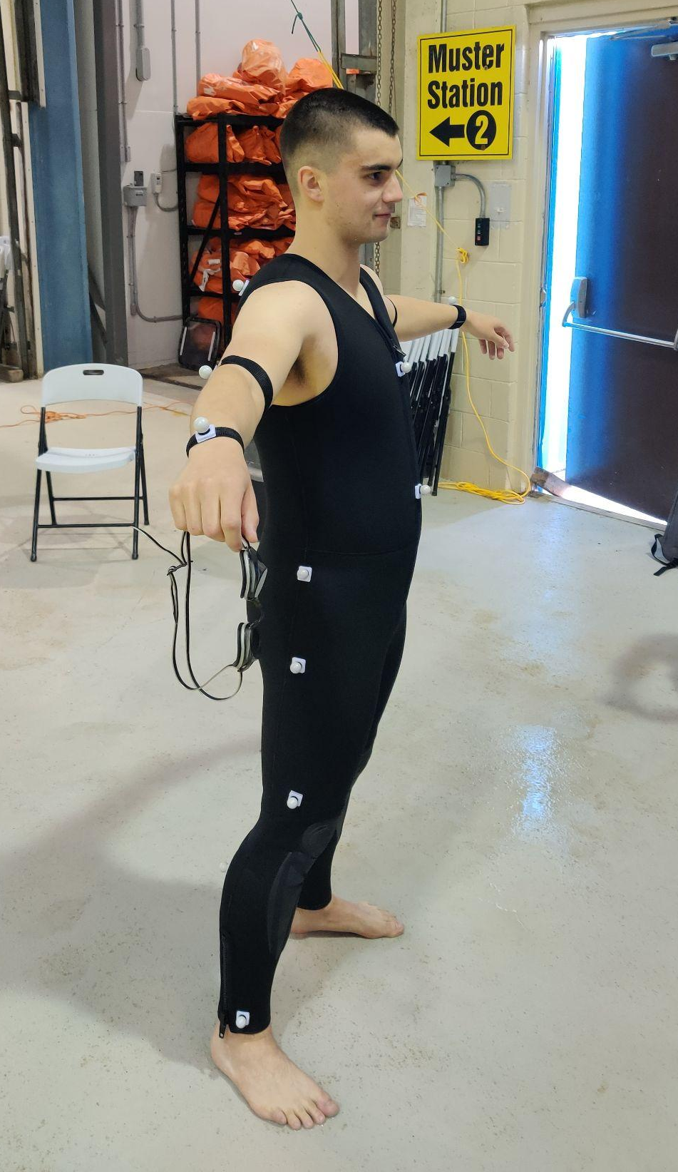
Marker positions

Slide 11
C3D data format
The captured data was exported as a C3D file format, where the three dimensional coordinates of each marker is convoluted to form the dataset.
The recorded dataset is unlabelled and full of noise.
To make this data usable the noise has to be cleaned and trimmed.

Slide 12
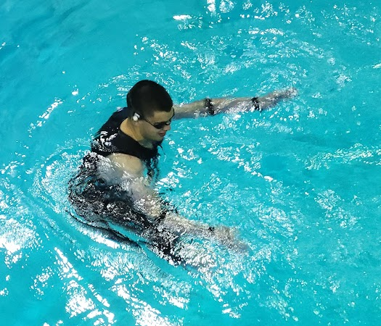
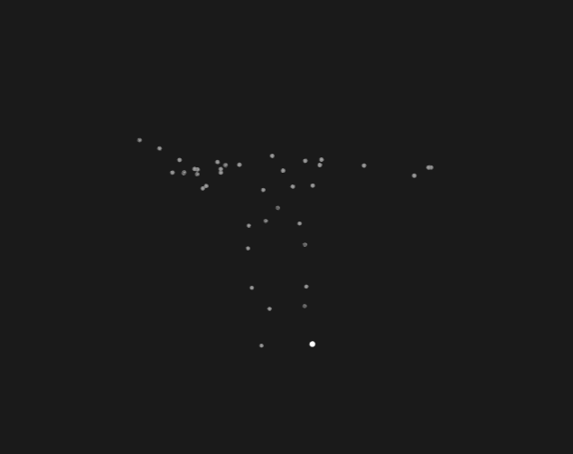
Noisy data
Here is a example of how noisy data is created.
In the above image our subject/diver is floating on the surface of the pool, creating ripples and waves on the surface.
The image below shows us the 3D coordinates of the subjects lower body and also capturing the surface reflections of the pool.
The cameras pick up the surface reflections as 3D marker points and captures the coordinates.
This data is unusable, meaning the deep learning model cannot be trained with so many unlabelled points.

Slide 13
Noise cleaning
To cleanup the data few methods can be used such as,
Manually cleaning the noise frame by frame.
Labour intensive and time consuming.
Have to edit thousands of frames.
The subject/diver has limited time underwater, thus the entire data is not useful.
Taking portion of the data that is mostly noise free.
Less amount of data to work with.
Mostly noise free
Eliminating the data from the surface of the pool to drastically reduce noise.
For the project, the second method was used where 8 small clips were prepared for training the model.
Notes:
No diving gear, thus limited time underwater.
All markers were visible for small duration of the video

Slide 14
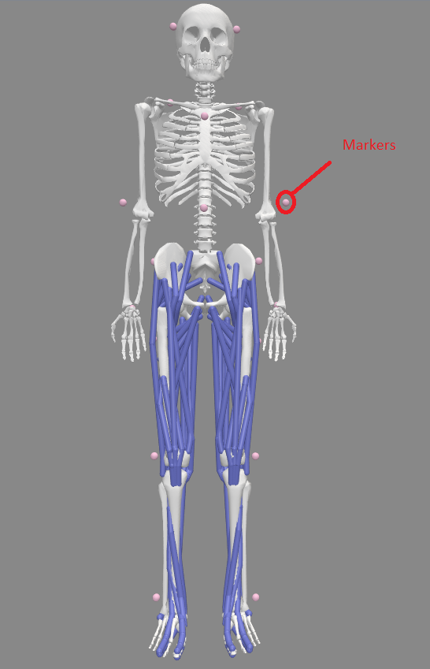
OpenSim Skeleton Model
An OpenSim skeleton model was constructed with the same marker set as our subject/diver. This skeleton has labelled markers, which will be used for error correcting the output of the deep learning network. The OpenSim skeleton has these three properties,
Segment Definition: The Skeleton Model is composed of multiple segments representing different body parts, such as the pelvis, thigh, shank, foot, and more.
Joint Connectivity: Joints connect the segments, defining the degrees of freedom and constraints for movement in the model.
Marker Placement: The Skeleton Model will include anatomical markers that help with motion capture data processing and alignment.

Slide 15
Ready to train.
With the labelled model skeleton and the training data, a deep learning network can be trained. The markers on the skeleton will emulate the body of a diver and the training dataset will represent the movement of the diver. This combined method of training will help the deep learning model to identify each marker and label it accordingly. The labelled markers then will be appended appropriately to estimate the posture of the unlabelled motion capture data.

Slide 16
Problem Breakdown
Label 3D points: The major challenge in human skeletonization is to identify the labeled 3d points of the figure. Combination of labeled data with the pre-made marker model are utilized to train a Deep Neural Network. The network predicts the label of each marker location.
Skeleton Construction: The labeled markers are then used to plot the skeleton.
Pose Estimation : The constructed skeleton represents the posture of the subject through motion capture.

Slide 17
Previous works on Labeling 3D points
One method is to initialize the labels in the first frame of data, and propagate the labels forward through time. But, this can fail, if the frame rate is insufficient, ghost markers appear, or the markers get obscured and subsequently emerge.[2]
Statistical methods like graph matching [3] and Gaussian mixture models [4] were used, but are susceptible to marker occlusions.
Another approach included depicting the 3D marker coordinates as a depth image while performing the marker labeling with convolutional neural networks.[5]
In Adaboost method, a collection of weak classifiers with the best performance is chosen based on the geometric connections between the markers to assign marker labels.

Slide 18
Overview of Labeling 3D points
The marker labeling technique incorporates labels to raw motion captured data based on probability predicted using a deep neural network.
The collected 3d motion data is stored in c3d format for training the Deep neural network.
The algorithm then validates and corrects the findings using a predefined marker set.

Slide 19
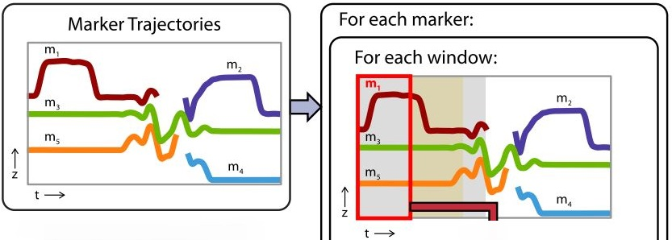
Data Pre-Processing
The marker coordinates is first rotated along the vertical axis based on the acromion markers so that the subject first faces the positive x-direction in order to prepare the data for input to the neural network.
A second-order zero-phase 6Hz Butterworth filter and low-pass filter is used on the trajectory data.
Less than 12-frame gaps are linearly interpolated.
Data was provided to the DNN as window size of 120.

Slide 20
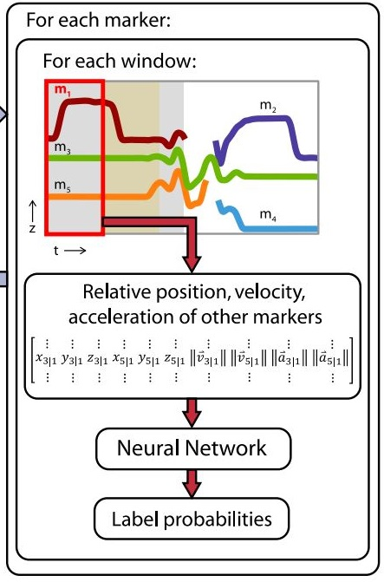
Neural Network
Long short-term memory units (LSTMs) based architecture was used for the Neural Network.
Long Short-Term Memory (LSTM) units are a type of recurrent neural network (RNN) architecture designed to handle long-term dependencies and retain information over extended sequences.
The number of frames for each window is made varied between 12-240 frames, ensuring that the neural network experienced windows of different sizes to handle the last window of each marker, which might be smaller unless there were 12 or fewer frames remaining.

Slide 21
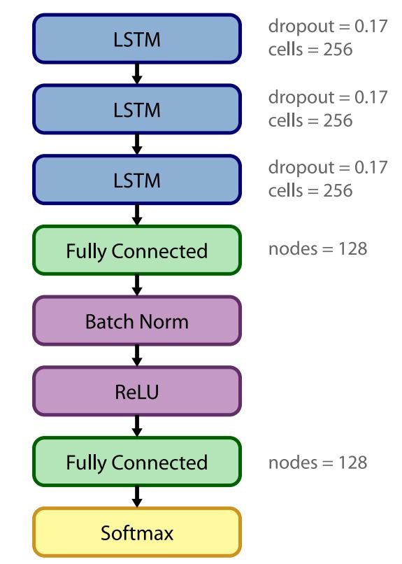
Neural Network Contd.
The model has 3 recurrent LSTM layers.
Each LSTM layer contains 256 cells and 0.17 dropout.
Layers are fully connected with 128 nodes.
The network uses 0.078 learning rate.

Slide 22
Label Assignment
The neural network's output for each window consisted of a 1 × N_{lbl} vector containing the probabilities of each label being correct.
The approach involved generating new windows by segmenting trial marker data at frames where markers appear or disappear, ensuring unique marker labels per window.
To address the challenge of potential label splitting across trajectories, the assignment of labels to windows is treated as an unbalanced assignment problem using a weighted bipartite graph, with the Hungarian algorithm used for optimal label assignment.
To achieve consistent labeling, the weighted mode assigns a single label to the entire marker trajectory. Probabilities are weighted, and instances of duplicated labels in simultaneous visible markers are corrected by keeping the marker with the highest probability.

Slide 23
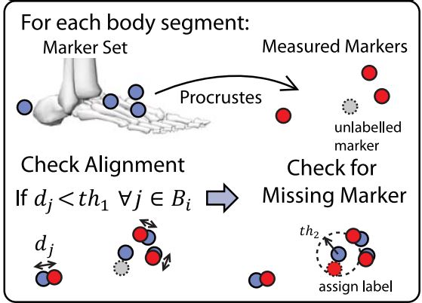
Label Verification
The OpenSim marker set represents local coordinates with respect to markers associated body segment. This is used to identify incorrectly labeled markers.
The distances between markers attached to the same body segment are calculated and compared to training dataset. Assigned label is removed, if the markers on same segment are outside of three standard deviations of the same markers in training set.
These unlabelled markers are labeled based on mean probabilities and distances to other markers within three standard deviations. The marker remains unlabelled if criterion not satisfied.
Finally, the marker set is used to attempt to assign labels for body segments in cases where at least three markers are identified, but one or more of them remain unlabelled.

Slide 24
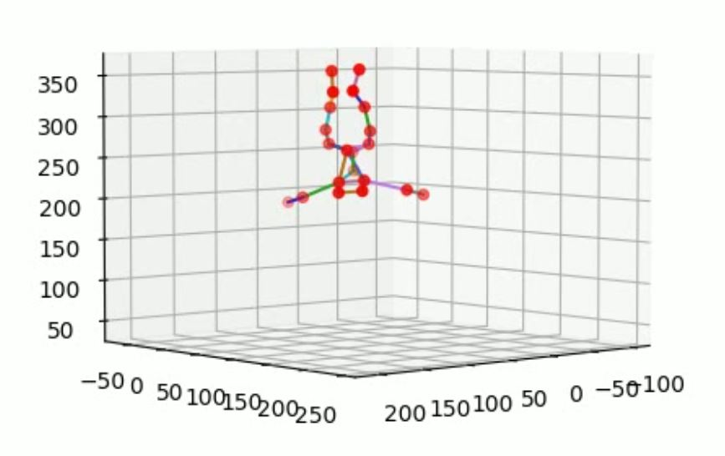
Skeleton Making
Creation of a skeleton representation is done by connecting the correctly labeled markers according to their anatomical relationships. Each connection forms a bone in the skeleton.
Each connection pair is then compared in the the labels present for each frames.
If pairs exists the connection is made. Else the pair is skipped.
This is done for each frames to plot the 3d skeleton of the subject underwater.
Each frames of skeleton are then combined to represent the changes of posture of the subject.

Slide 25
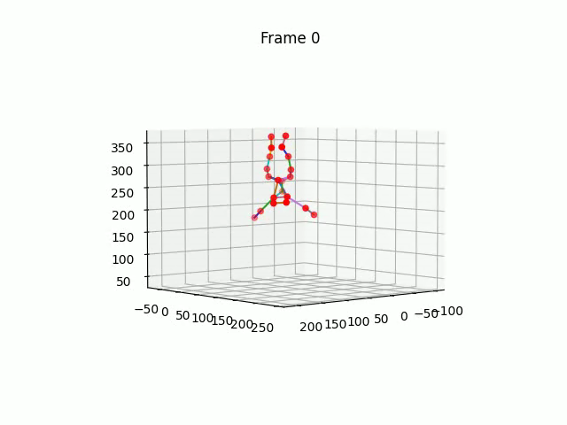
Visual Representation

Slide 26
Challenges and Limitations
Expensive motion capture system.
Marker location selection and attaching to the diver.
The buoyancy of the subject and inherent limitation of underwater motion capture.
Stretching the limits of the camera system with respect to the water body.
Finding appropriate model for training.
Lack of quality data.

Slide 27
Future potentials
Running more trials to gather improved data.
Can be developed as a way to inspect underwater safety training for divers.
Can be used on autonomous underwater vehicles (AUVs) to track deep sea divers.

Slide 28
References
Qualisys. https://www.qualisys.com/cameras/underwater/
G. B. Guerra-Filho, "Optical motion capture: Theory and implementation", J. Theor. Appl. Informat., vol. 12, no. 2, pp. 61-89, 2005.
S. Xia, L. Su, X. Fei and H. Wang, "Toward accurate real-time marker labeling for live optical motion capture", Vis. Comput., vol. 33, no. 6, pp. 993-1003, Jun. 2017.
S. Alexanderson, C. O’Sullivan and J. Beskow, "Real-time labeling of non-rigid motion capture marker sets", Comput. Graph., vol. 69, pp. 59-67, Dec. 2017.
S. Han, B. Liu, R. Wang, Y. Ye, C. D. Twigg and K. Kin, "Online optical marker-based hand tracking with deep labels", ACM Trans. Graph., vol. 37, no. 4, pp. 1-10, Aug. 2018.
J. L. J. Bascones, M. Graña and J. M. Lopez-Guede, "Robust labeling of human motion markers in the presence of occlusions", Neurocomputing, vol. 353, pp. 96-105, Aug. 2019.

Slide 29
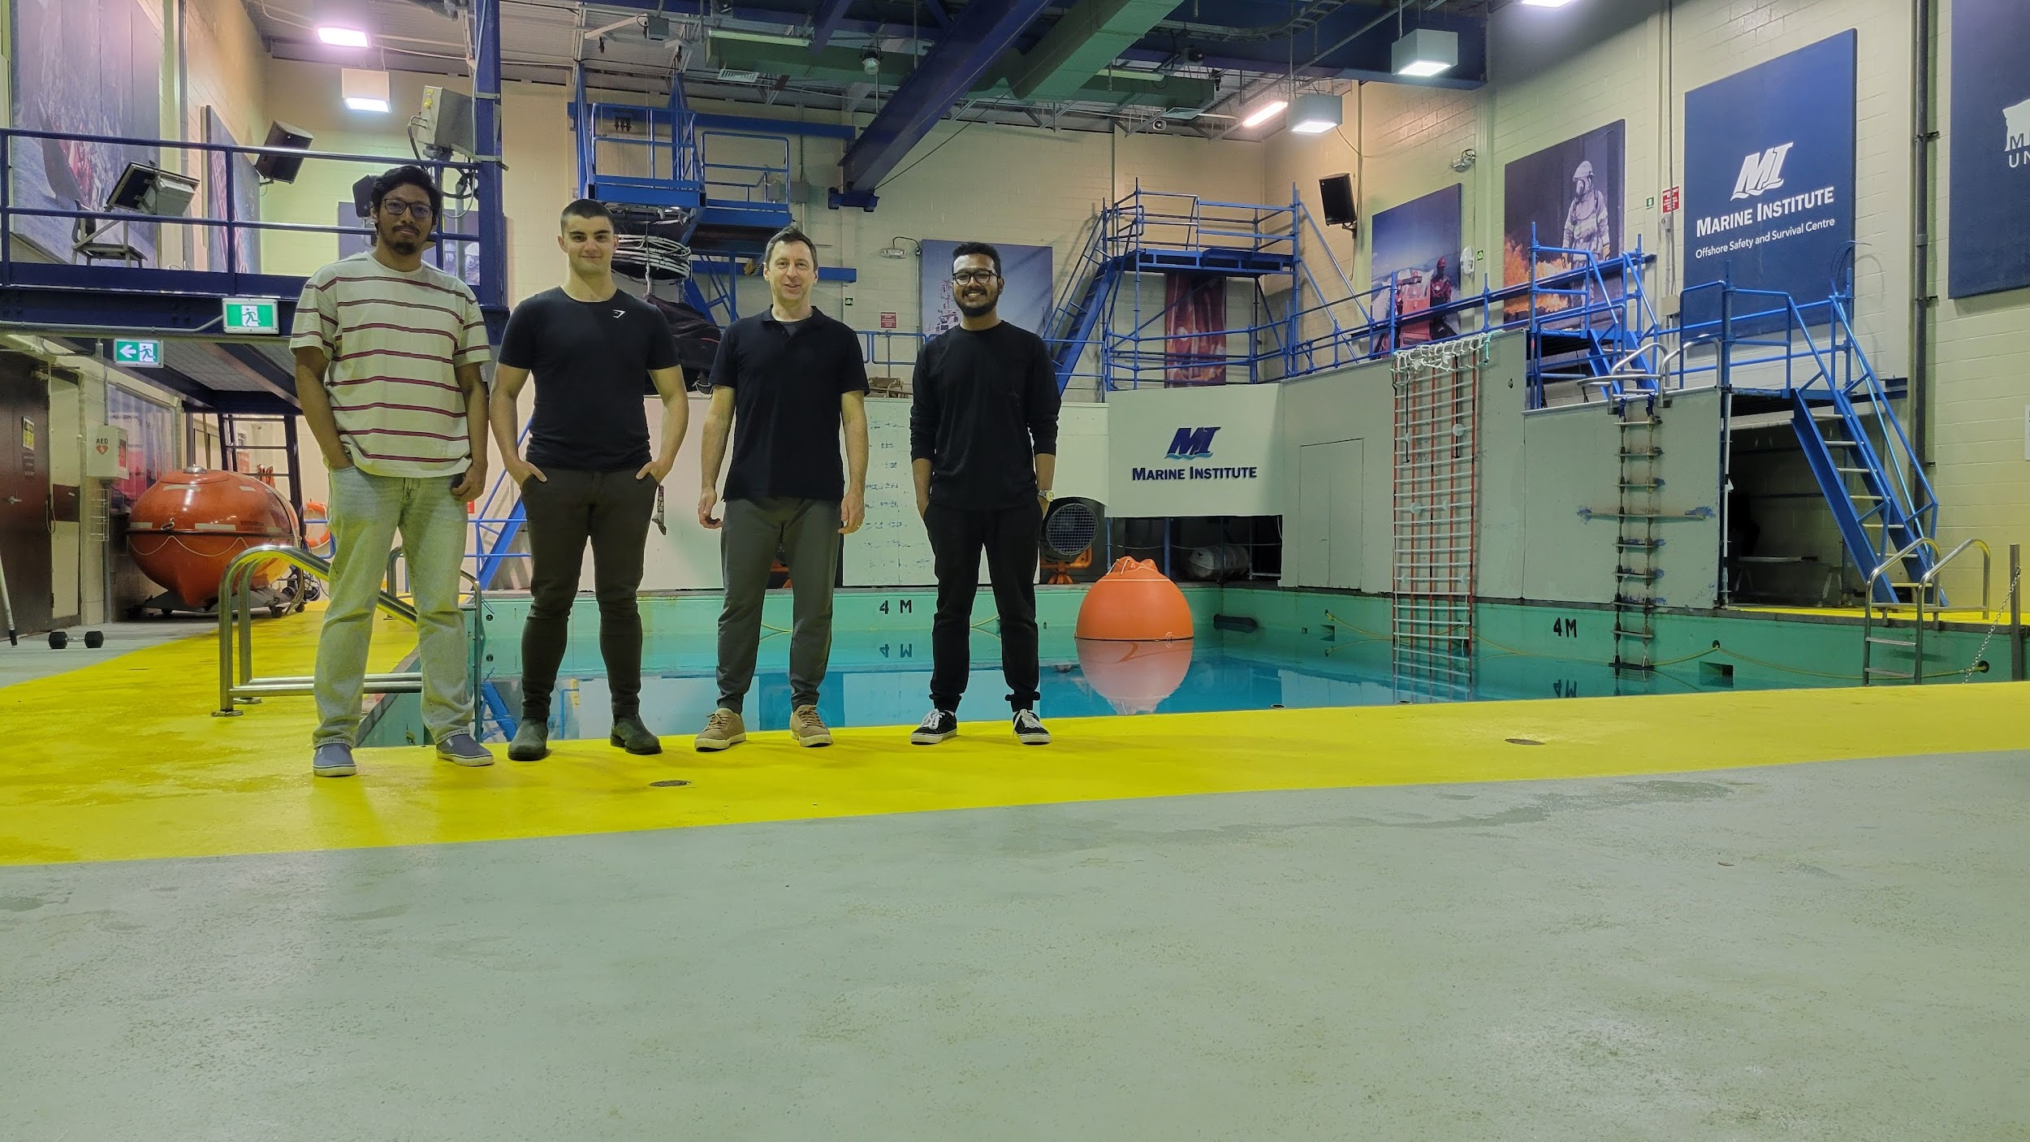
Special Thanks to Dr. Czarnuch Cody and Zach

